Slide 1


Updates
Olivier Bergeron

Slide 2

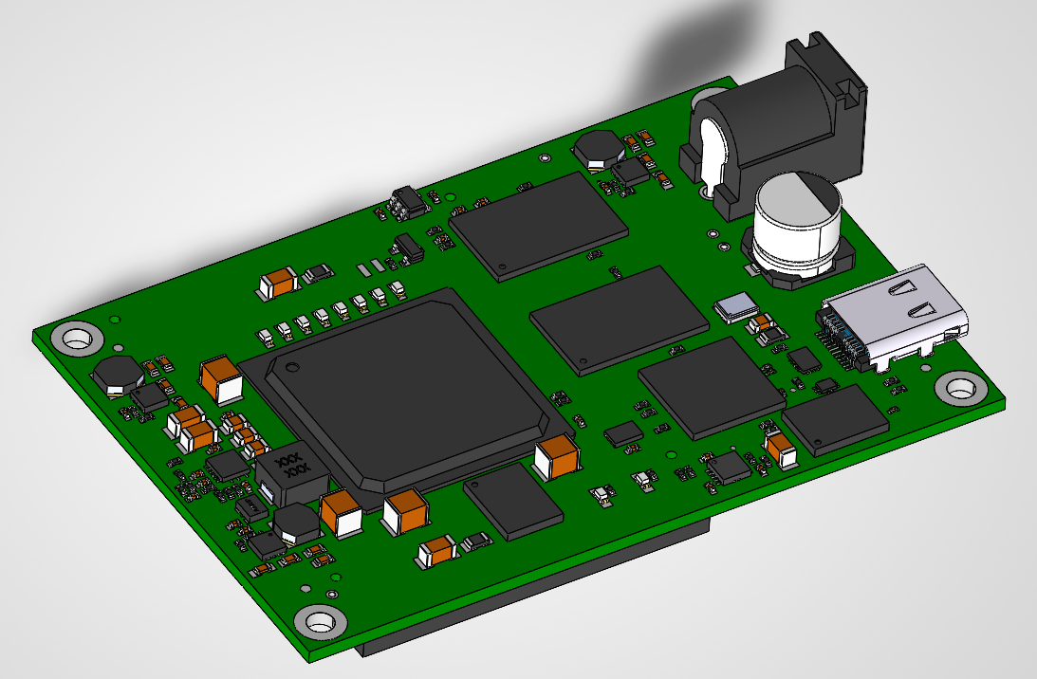
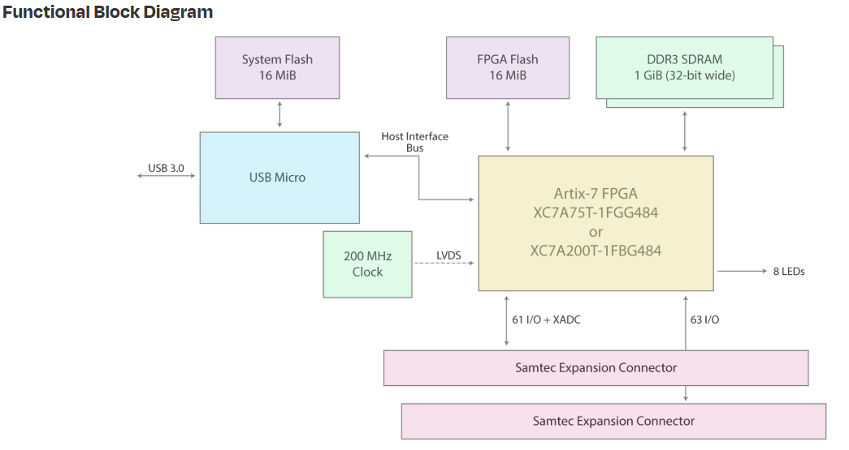
FPGA Devkit

Slide 3
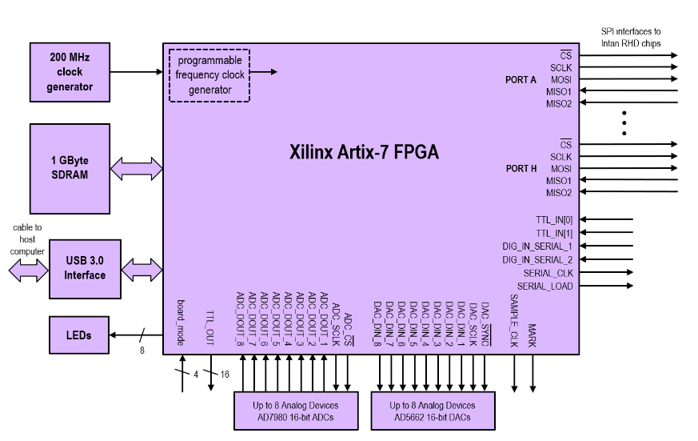
FPGA Devkit

Slide 4
FPGA Devkit
What’s missing:
Breakout board for devkit
LVDS Transceiver
Connectors
I/O Breakout
Intan 64 channels

Slide 5
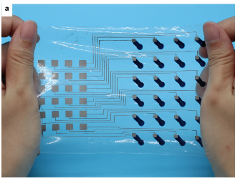
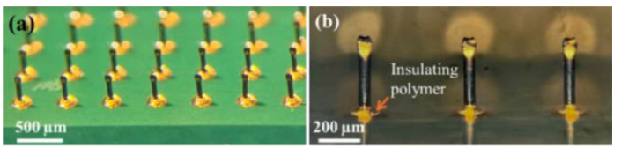
Electrode process
In communication with
COPL
Waiting for their answer on what they can do
University of Calgary
Meeting next week for microneedle approach

Slide 6
Electrode impedance bench
Printing in progress
Design tuning will need to be done

Slide 7
What’s next
Continue printing and fine tuning
Meeting and follow up on electrode fabrication process
When FPGA devkit arrives, try to run the code made by Intan
Design breakout board for FPGA devkit

